Slide 1




CHUBB
ANDHRA HEALTH DATA
Data warehousing using Informatica and Data Analysis using Python
(Capstone Project)

Slide 2

CHUBB
About Dataset
It is dataset collected from various private and government hospitals in Andhra Pradesh.It contains information about various patients like their age, sex, caste and address. It also has Detail about the type of disease a particular person is suffering from and surgery type assigned to him/her.It also has details about discharge date, mortality status and date etc and also contains details about the hospital.

Slide 3
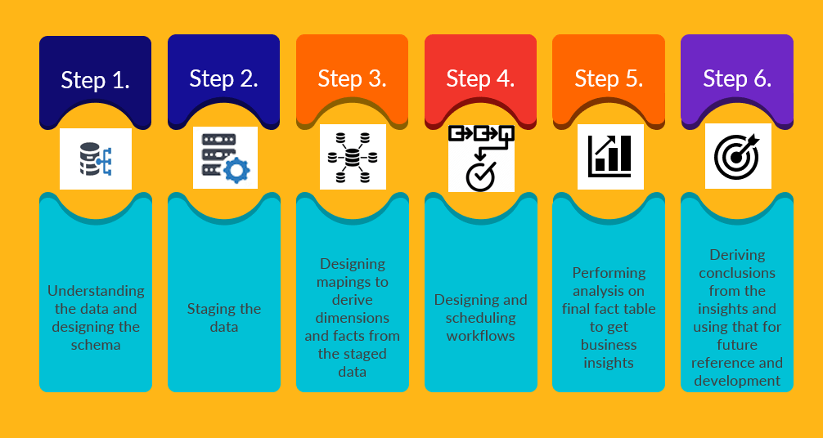
CHUBB

Slide 4
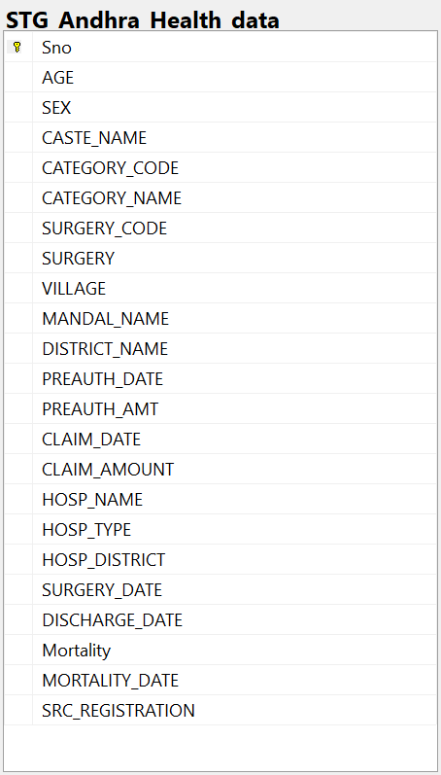
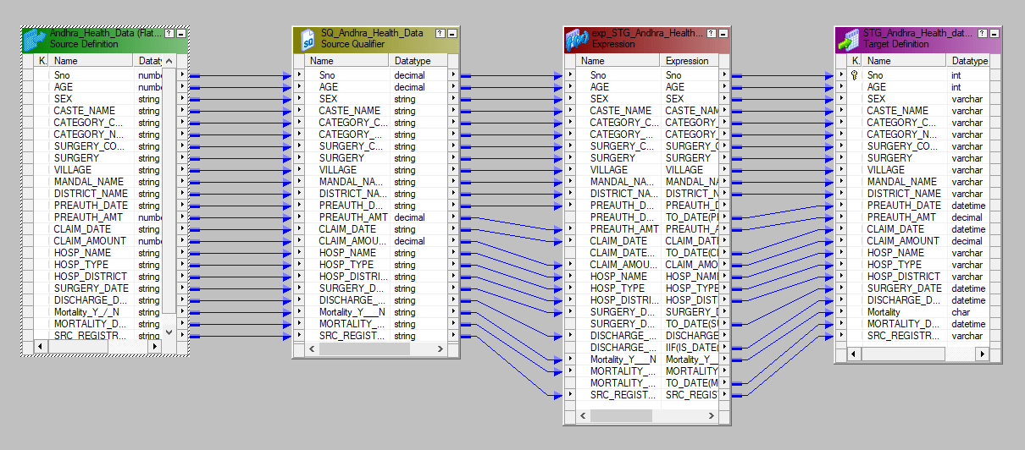
CHUBB
Staging table Design
Staging

Slide 5
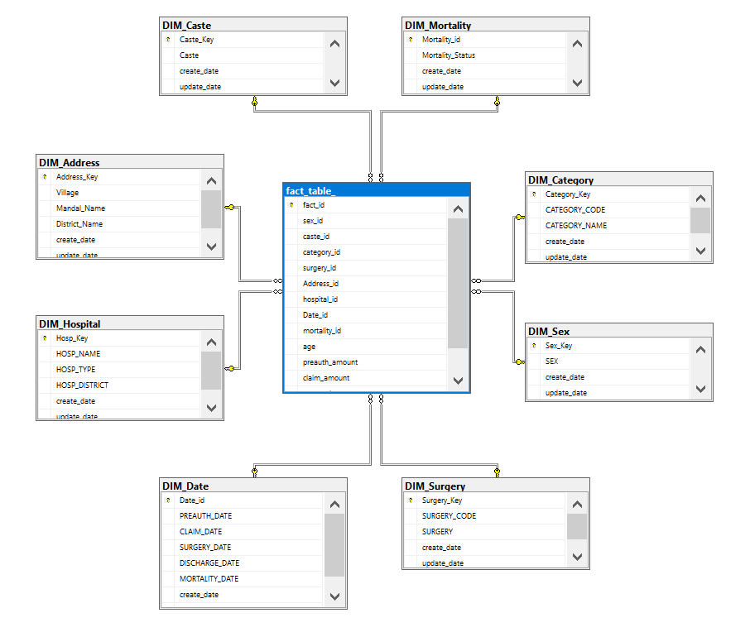
CHUBB
Data Warehouse Design

Slide 6
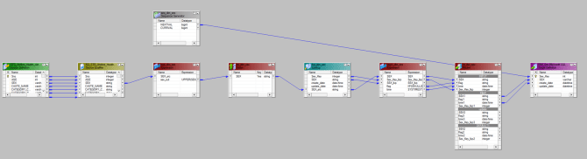
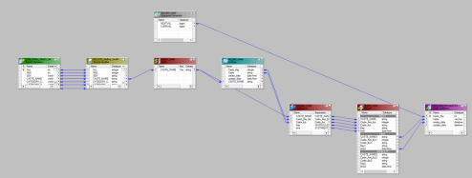
CHUBB
DIM_SEX
DIM_CASTE

Slide 7
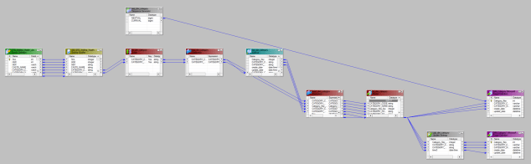
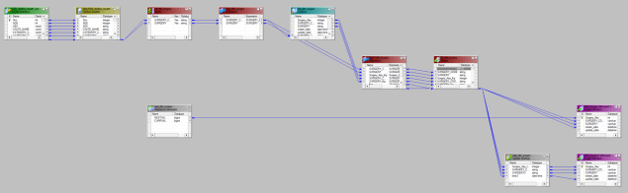
DIM_CATEGORY
CHUBB
DIM_SURGERY

Slide 8
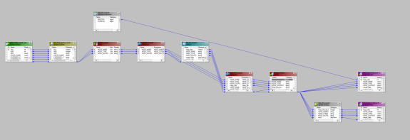
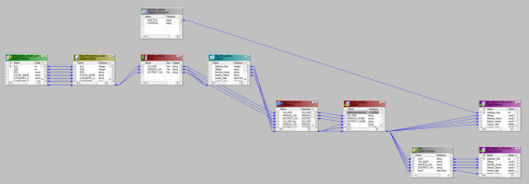
DIM_HOSPITAL
CHUBB
DIM_ADDRESS

Slide 9
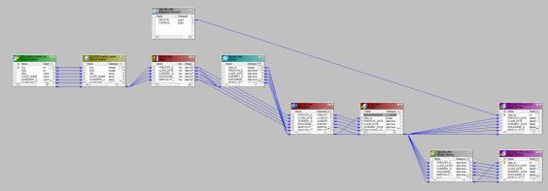
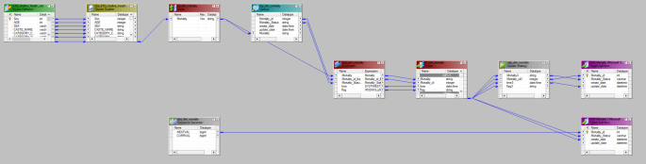
CHUBB
DIM_DATES
DIM_MORTALITY

Slide 10
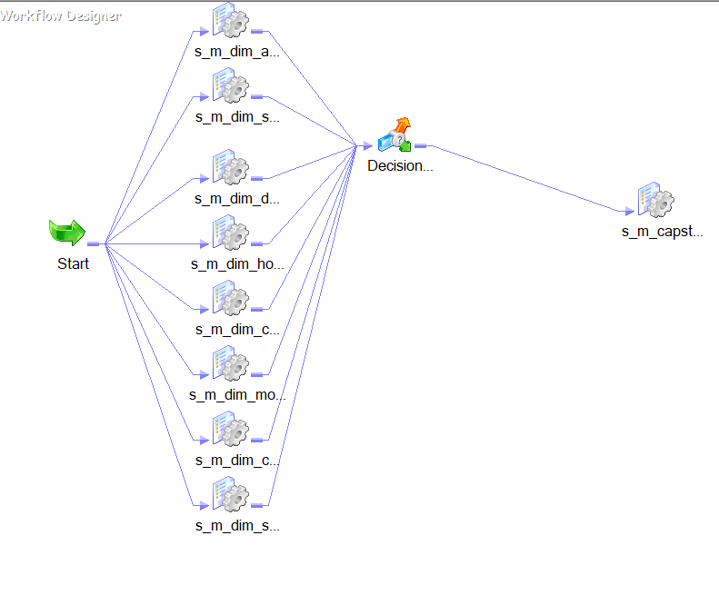
CHUBB
Fact_Workflow
CHUBB
Checks whether the session is succeed or not

Slide 11
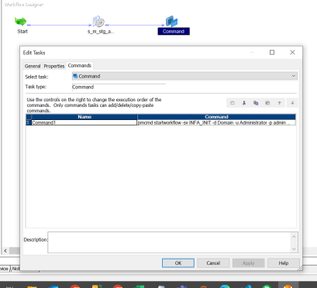
CHUBB
Staging_Workflow(PMCMD)
PMCMD COMMAND

Slide 12
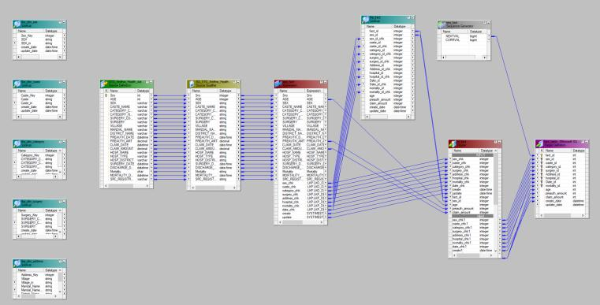
CHUBB
Fact_table

Slide 13
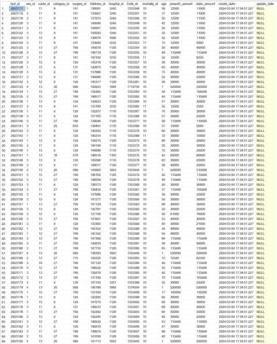
CHUBB
Fact_table

Slide 14
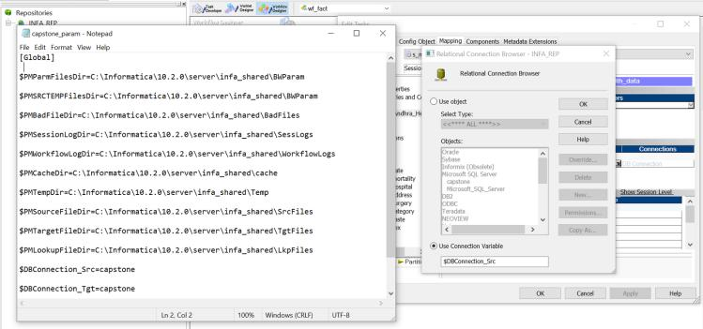
Parameterization

Slide 15
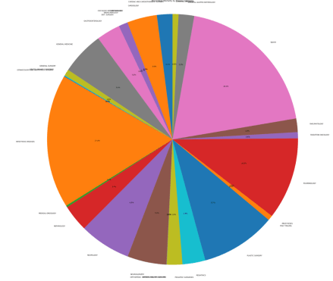
Insights
1.Mortality Percentage For different category of Diseases

Slide 16
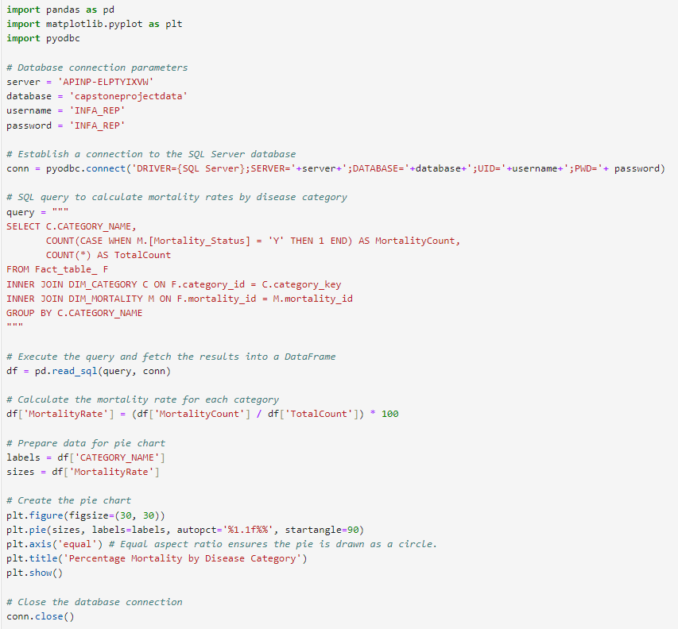
Insights

Slide 17
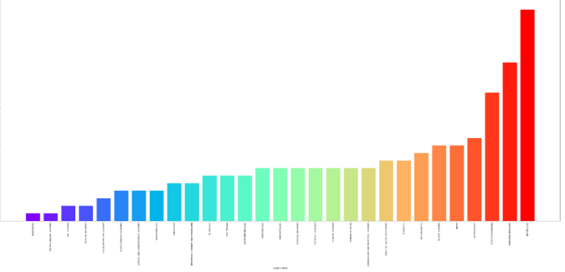
Insights
2.Average Recovery Rates for different Diseases

Slide 18
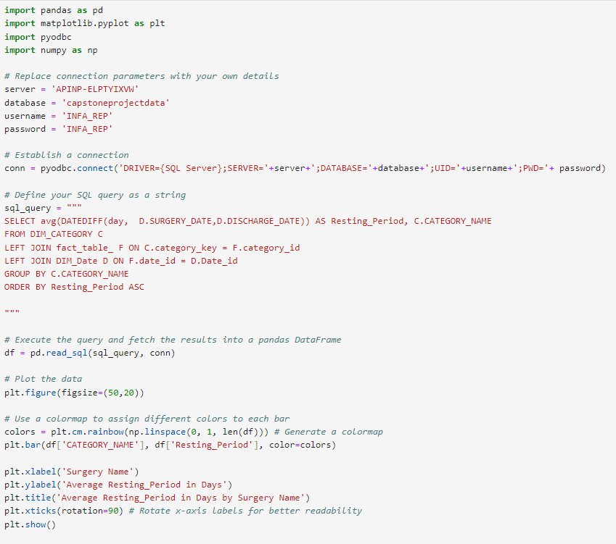
Insights

Slide 19
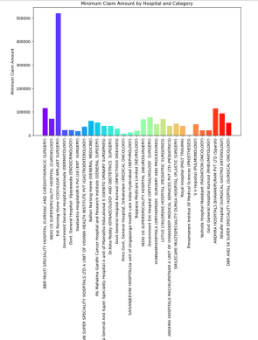
Insights
3.Cheapest Hospitals for each Category of Disease

Slide 20
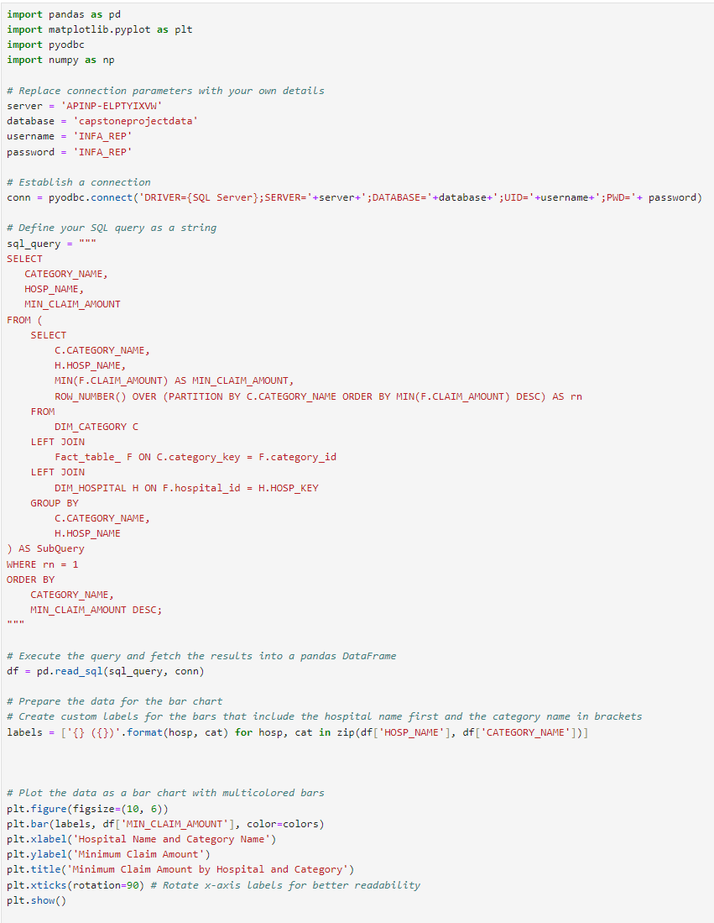
Insights

Slide 21
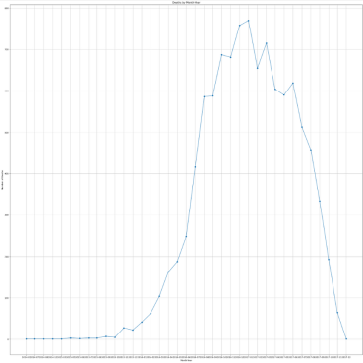
Insights
4.No of Deaths Year-Month wise

Slide 22
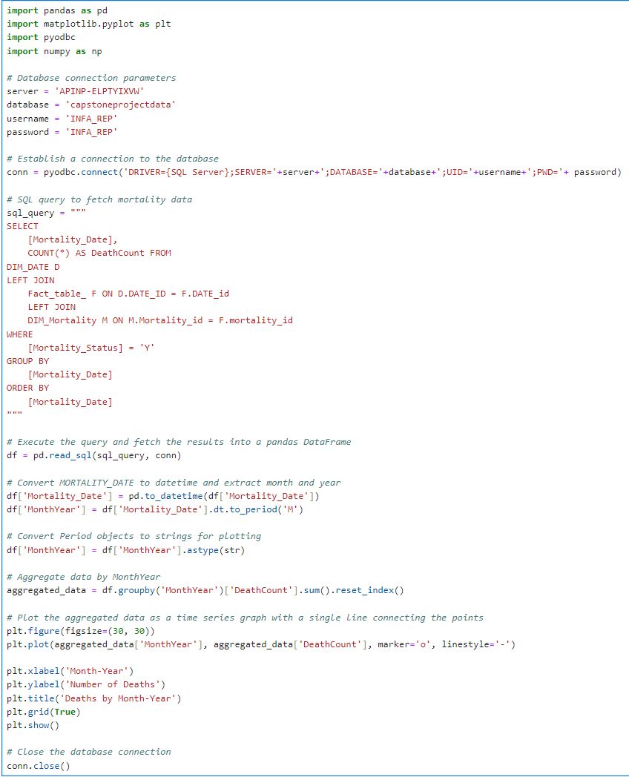
Insights

Slide 23
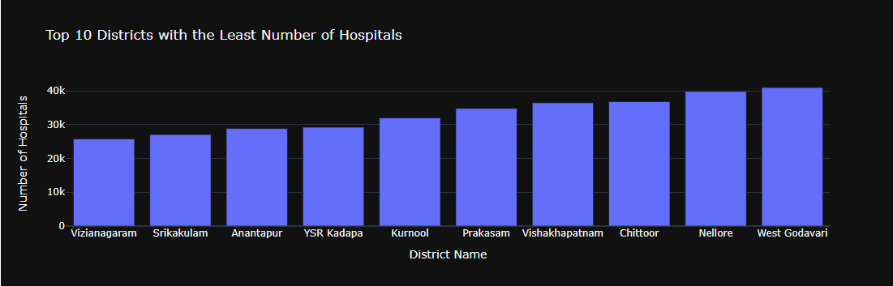
Insights
5.Top 10 Dustricts with least Number of Hospitals

Slide 24
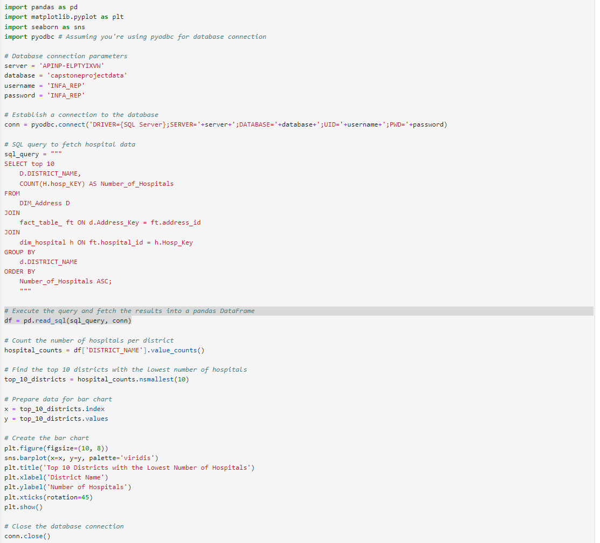
Insights

Slide 25
Thank you

